Slide 1



Science Communication: Out of the Silos and into the Media
Rachel Abraham
Mentor: Daniel Stolte, University Communications
Arizona Space Grant Symposium
Hosted by the University of Arizona
April 18, 2020

Slide 2
The Issue With Science Papers
The readability of science papers has significantly decreased since 1881!
(from Plavin-Sigray et al., 2017)
Can you understand this?
“RNA affinity antisense purification–mass spectrometry (RAP-MS) revealed MaIL1 binding to optineurin (OPTN), a ubiquitin-adapter platforming TBK1 kinase. MaIL1 binding stabilized OPTN, and consequently, loss of MaIL1 blunted OPTN aggregation, TBK1-dependent IRF3 phosphorylation, and type I interferon (IFN) gene transcription downstream of TLR4.” (from Aznaourova et al. 2020)

Slide 3
Where Science Communicators Step In
Science communicators take jargon and translate it into something the everyday person could understand.
Life of A Story:
News release published by University Communications
Story gets picked up by larger media outlets
Paper published in science journal

Slide 4
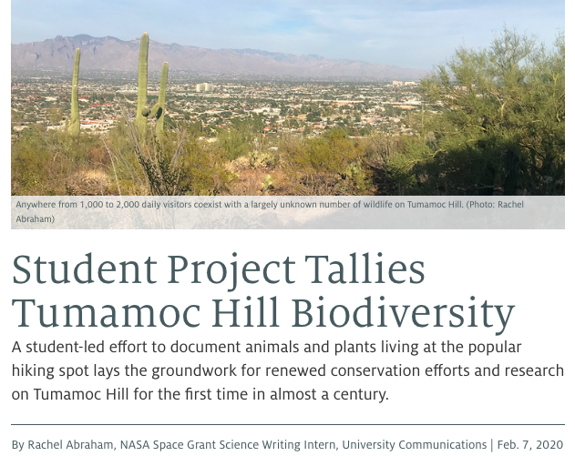
Other Forms of Science Communication
While I worked on news releases, here are some other forms!
Oral presentations
Popular science articles
Conferences
Movies/TV shows
Podcasts
Educational programs/outreach

Slide 5
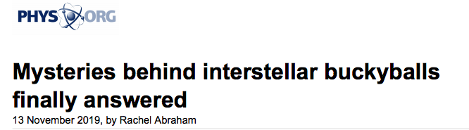
Why Bother Going Through Communicators?
Exponentially increase the reach of your work
Have more oversight over the explanation of your research
Earn recognition for your work!
Could help gain future funding or collaborators

Slide 6
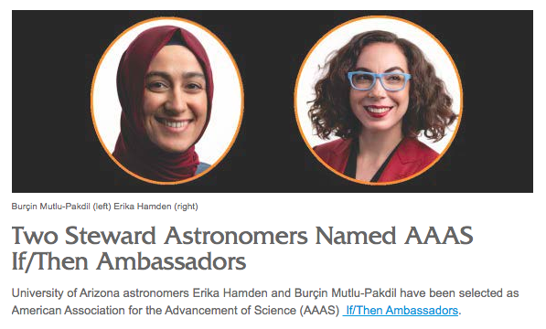
The Process
Find a “newsworthy” paper
Research/Interview prep
Interview the writers
Write your draft
Review and edit
Publish

Slide 7
What to Look For When Interviewing
What’s the main takeaway from the paper?
What significance does it have?
Have the researchers explain their work in their own words
Clarify any confusion on technical terms
Get them to explain the work as if they were talking to their non-science trained friend

Slide 8
Review
Frequently send drafts of the piece to researchers for review
Allow them to correct any technical misunderstandings
Make adjustments to quotes for clarity
Double check for any unexplained jargon
Correct any grammatical errors

Slide 9
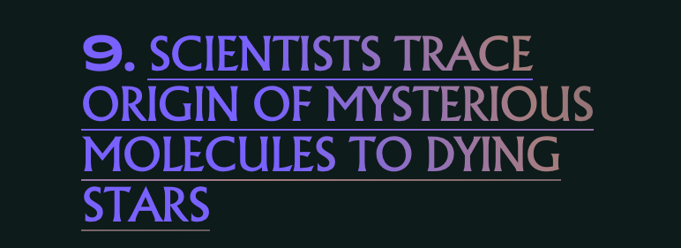
Publishing Successes
My story on Buckyball origins were picked up by multiple large outlets including:
Inverse, Sky News, Futurity, Phys.org
A front page spot on the Department of Energy’s Science Page
Listed #9 on Inverse’s Top 20 “Wildest Space Discoveries of 2019”

Slide 10
Acknowledgements
Special thanks to Mickayla Mace, Stacy Pigott, and everyone else at UA Communications
Thank you to the Arizona Space Grant Consortium

Slide 11
Thank you!

